Slide 1
Multithreaded Programming
Daiwat Vyas

Slide 2
Introduction to Multithreading
Why Multithreading?
Make the UI more responsive
Take advantage of multiprocessor systems
Simplify modeling in simulation application
Perform asynchronous or background processing
Notes:
Make the UI more responsive - Event-driven UI toolkits, such as AWT and Swing, have an event thread that processes UI
events such as keystrokes and mouse clicks.
AWT and Swing programs attach event listeners to UI objects. These listeners are notified when a specific event occurs, such as a button being clicked. Event listeners are called from within the AWT event thread.
If an event listener were to perform a lengthy task, such as checking spelling in a large document, the event thread would be busy running the spelling checker, and thus would not be able to process additional UI events until the event listener completed. This would make the program appear to freeze, which is disappointing for the user.
To avoid stalling the UI, the event listener should hand off long tasks to another thread so that the AWT thread can continue processing UI events (including requests to cancel the long-running task being performed) while the task is in progress.
Take advantage of multiprocessor systems - Multiprocessor systems are much more common than they used to be. Once they were found only in large data centers and scientific computing facilities. Now many low-end servers systems -- and even some desktop systems -- have multiple processors. Modern operating systems, including Linux, Solaris, and Windows NT/2000, can take advantage of multiple processors and schedule threads to execute on any available processor.
The basic unit of scheduling is generally the thread; if a program has only one active thread, it can only run on one processor at a time. If a program has multiple active threads, then multiple threads may be scheduled at once. In a well-designed program, using multiple threads can improve program throughput and performance.
Simplify modeling - In some cases, using threads can make your programs simpler to write and maintain. Consider a simulation application, where you simulate the interaction between multiple entities. Giving each entity its own thread can greatly simplify many simulation and modeling applications.
Another example where it is convenient to use separate threads to simplify a program is when an application has multiple independent event-driven components, for example, an application might have a component that counts down the number of seconds since some event and updates a display on the screen. Rather than having a main loop check the time periodically and update the display, it is much simpler -- and less error-prone -- to have a thread that does nothing but sleep until a certain amount of time has elapsed and then update the on-screen counter. This way the main thread doesn't need to worry about the timer at all.
Perform asynchronous or background processing - Server applications get their input from remote sources, such as sockets. When you read
from a socket, if there is no data currently available, the call to SocketInputStream.read() will block until data is available. If a single-threaded program were to read from the socket, and the entity on the other end of the socket were never to send any data, the program would simply wait forever, and no other processing would get done. On the other hand, the program could poll the socket to see if data was available, but this is often undesirable for performance reasons.
If, instead, you created a thread to read from the socket, the main thread could perform other tasks while the other thread waited for input from the socket. You can even create multiple threads so you can read from multiple sockets at once. In this way, you are notified quickly when data is available (because the waiting thread is awakened) without having to poll frequently to check if data is available. The code to wait on a socket using threads is also much simpler and less error-prone than polling would be.

Slide 3
Multithreading & Multitasking
Two types of Multitasking:
Thread based
Process based
A Process is a program which is under execution
Process based multitasking allows to execute two or more programs concurrently

Slide 4
Multithreading & Multitasking (Contd…)
In process based multitasking, a program is the smallest unit of code that can be dispatched by the scheduler
In thread based multitasking, a thread is the smallest unit of code that can be dispatched by the scheduler
This means that a single program can have two or more tasks which can be executed simultaneously
Multithreading – Thread based Multi Tasking

Slide 5
What is a Thread?
A Thread is an independent, concurrent path of execution through a program
Threading is a facility to allow multiple activities to execute simultaneously within a single process
Sometimes referred to as lightweight processes
Every process has at least one thread - the main thread

Slide 6
Multithreading Example
Consider your basic word processor
You have just written a large amount of text in MS Word editor and now hit the save button
It takes a noticeable amount of time to save new data to disk, this is all done with a separate thread in the background
Without threads, the application would appear to hang while you are saving the file and be unresponsive until the save operation is complete

Slide 7
Implementing Multithreading
Two ways:
Extending the Thread Class
Implementing the Runnable Interface
Thread
(class)
One Way
Runnable (interface)
Another Way
extends
implements
MyThread
MyThread

Slide 8
The Main Thread
When a Java program starts up, one thread begins running immediately. This is usually called the main thread of your program.
It is the thread from which other “child” threads will be spawned.
Often, it must be the last thread to finish execution because it performs various shutdown actions.
The main thread is created automatically when your program is started.
It can be controlled through a Thread object. To do so, you must obtain a reference to it by calling the method currentThread( ), which is a public static member of Thread.
Its general form is shown here:
static Thread currentThread( )
This method returns a reference to the thread in which it is called.
Once you have a reference to the main thread, you can control it just like any other thread.

Slide 9
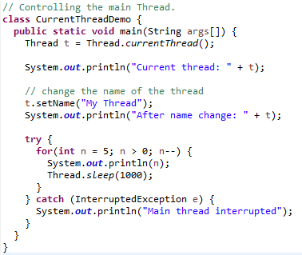
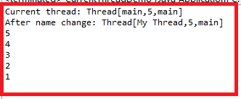
Current Thread

Slide 10
Extending the Thread Class
Create a new class that extends Thread
Override the run() method, which is the entry point of the new thread, in the subclass from the Thread class to define the code executed by the thread
public class ThreadExample extends Thread
{
private String data;
public ThreadExample(String data) {
this.data = data;
}
public void run() {
System.out.println(“I am a thread with ”+data);
}
}

Slide 11
Running Threads
Create an instance of this subclass (ThreadExample)
Invoke the start() method on the instance of the class to make the thread eligible for running
public class ThreadExampleMain
{
public static void main(String[] args) {
Thread myThread = new ThreadExample(“my data”);
myThread.start();
}
}

Slide 12
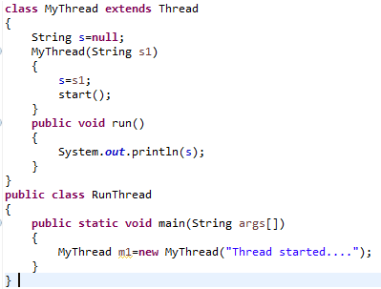

Extending Thread Class

Slide 13
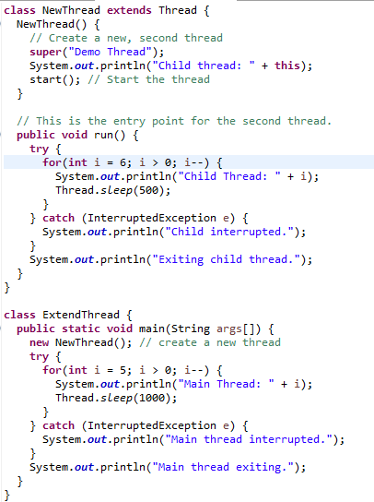
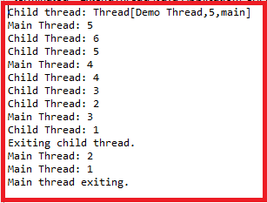
Extending Thread Class

Slide 14
Using the Runnable Interface
Choosing an Approach:
Classes should be extended only when they are being enhanced or modified in some way. So, if you will not be overriding any of Thread’s other methods, it is probably best to implement Runnable.
Implement the Runnable interface
Override the run() method to define the code executed by thread
public class RunnableExample extends SomeClass
implements Runnable
{
private String data;
public RunnableExample(String data) {
this.data = data;
}
public void run() {
System.out.println(“I am a thread: ”+data);
}
}

Slide 15
Using the Runnable Interface (Contd…)
Create an object of Thread class
Invoke the start() method on the instance of the Thread class
public class RunnableExampleMain
{
public static void main(String[] args) {
RunnableExample myRunnableObject = new
RunnableExample(“my data”);
Thread myThread = new Thread(myRunnableObject);
myThread.start();
}
}

Slide 16
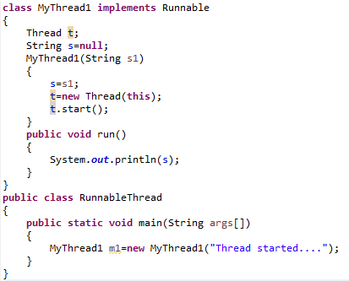
Using the Runnable Interface (Contd…)

Slide 17
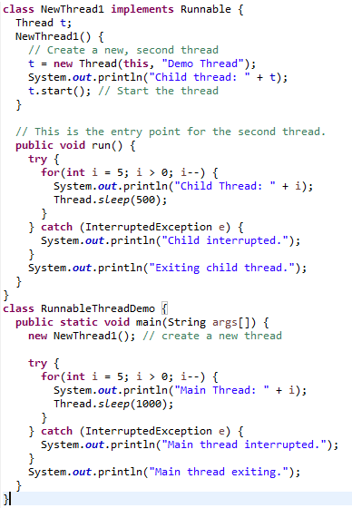
Using the Runnable Interface (Contd…)

Slide 18
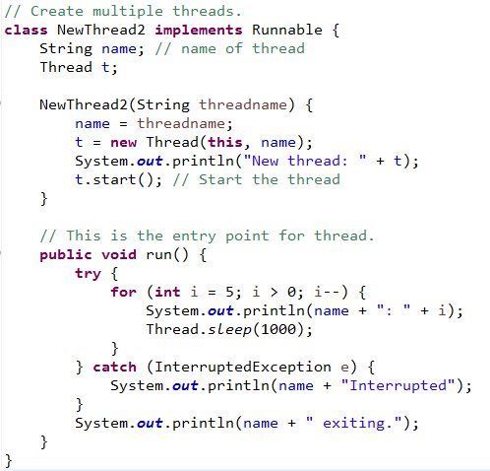
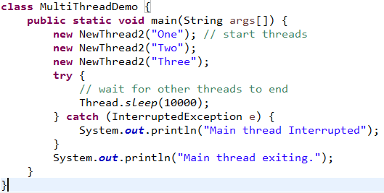
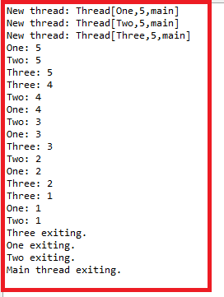
Creating Multiple Threads

Slide 19
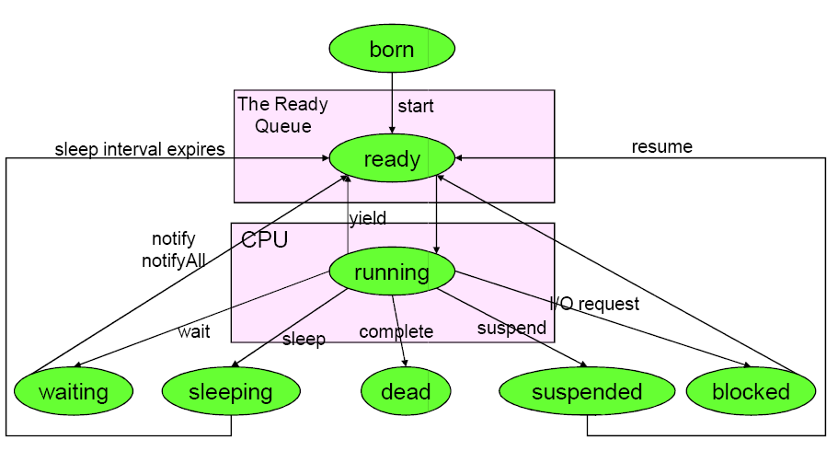
Thread Life Cycle

Slide 20
Thread Life Cycle (Contd…)
A Thread object has the following states in its lifecycle:
Born | The thread object has been created
Ready / Runnable | The thread is ready for execution
Running | The thread is currently running
Blocked | The thread is blocked for some operation (e.g. I/O Operations)
Sleeping | The thread is not utilizing its time slice till the timer elapses
Suspended | The thread is not utilizing its time slice till resume() is called
Waiting | Thread enters into waiting on calling wait() method
Dead | The thread has finished execution or aborted (The dead thread cannot be started again)

Slide 21
Using sleep(), yield()
Once a thread gains control of the CPU, it will execute until one of the following occurs:
Its run() method exits
A higher priority thread becomes runnable & pre-empts it
Its time slice is up (on a system that supports time slicing)
It calls sleep() or yield()
yield() | the current thread paused its execution temporarily and has allowed other threads to execute
sleep() | the thread sleeps for the specified number of milliseconds, during which time any other thread can use the CPU

Slide 22
Using join()
A call to the join method on a specific thread causes the current thread to block until that thread is completed
public class ThreadExampleMain
{
public static void main(String[] args) {
Thread myThread = new ThreadExample(“my data”);
myThread.start();
System.out.println(“I am the main thread”);
myThread.join();
System.out.println(“waiting for myThread”);
}
}

Slide 23
Using isAlive() and join()
final boolean isAlive( )
The isAlive( ) method returns true if the thread upon which it is called is still running. It returns false otherwise.
final void join( ) throws InterruptedException
This method waits until the thread on which it is called terminates.
Additional forms of join( ) allow you to specify a maximum amount of time that you want to wait for the specified thread to terminate.

Slide 24
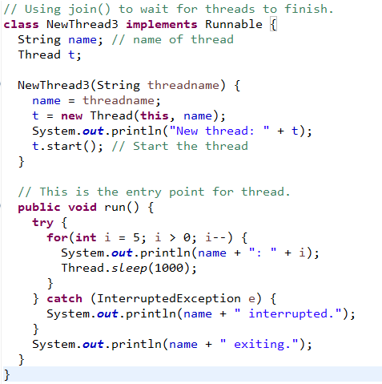
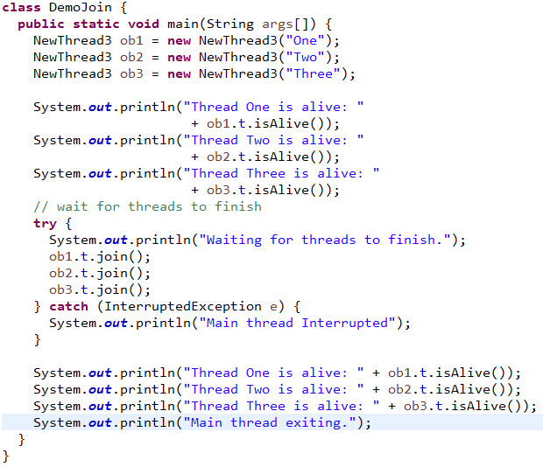
Using isAlive() and join()

Slide 25
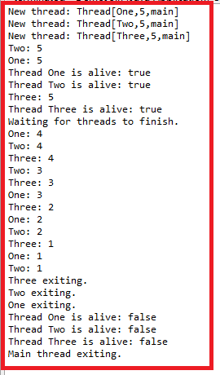
Using isAlive() and join()

Slide 26
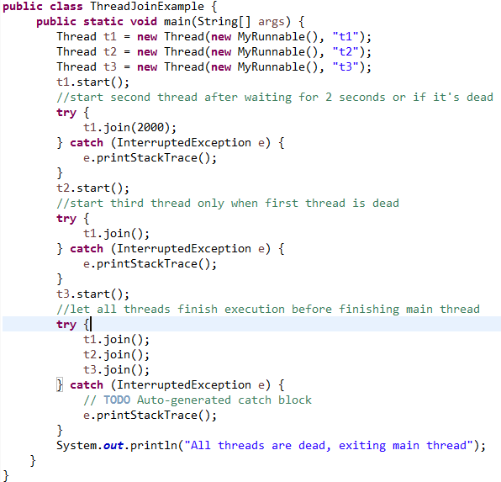
Using join()

Slide 27
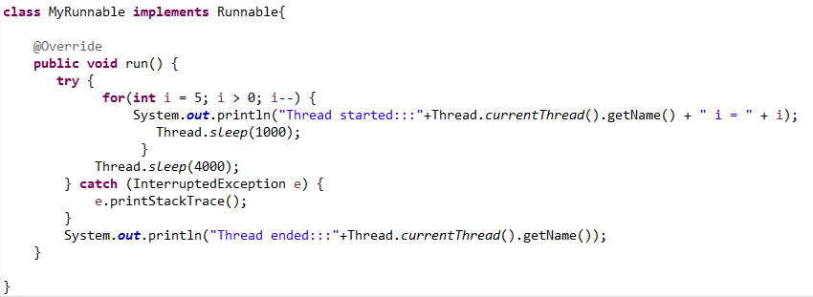
Using join()

Slide 28
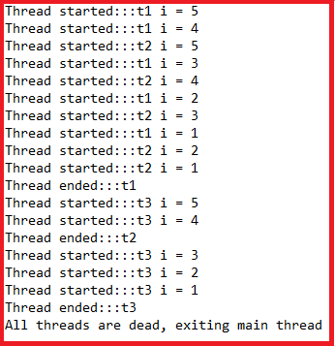
Using join()

Slide 29
Other Thread Operations
interrupt() method
If any thread is in sleeping or waiting state (i.e. sleep() or wait() is invoked), calling the interrupt() method on the thread, breaks out the sleeping or waiting state throwing InterruptedException.
If the thread is not in the sleeping or waiting state, calling the interrupt() method performs normal behaviour and doesn't interrupt the thread
interrupted() method
Returns a boolean value indicating the interrupted status of the current thread & resets the same to not interrupted
A combination of these two methods is useful for requesting a thread to yield, sleep or terminate

Slide 30
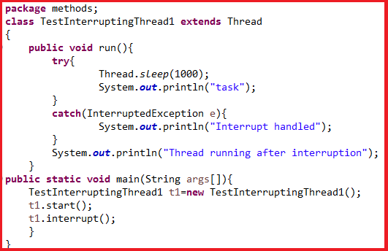
Using interrupt( )

Slide 31
Give this a Try
After executing run() method completely, thread enters in which state?
If thread is running, and sleep() method is invoked, it enters in which state?
If thread is running, & there is some I/O operations in the program, thread enters in which state?
Notes:
Dead
Sleeped
Blocked

Slide 32
Thread Priorities
The JVM chooses which thread to run according to a “fixed priority algorithm”
Every thread has a priority between the range of Thread.MIN_PRIORITY(1) and Thread.MAX_PRIORITY(10)
To return a thread to default priority, specify NORM_PRIORITY, which is currently 5.
These priorities are defined as static final variables within Thread.
By default a thread is instantiated with the same priority as that of the thread that created it
Thread priority can be changed using the setPriority() method of the Thread class
final void setPriority (int level)

Slide 33
Thread Priorities (Contd…)
Thread priority can be obtained using the getPriority() method of the Thread class
final int getPriority()
Threads with higher priorities are run to completion before Threads with lower priorities get a chance of CPU time
The algorithm is preemptive, “pre-empting means snatching the control of execution from lower priority threads”, so if a lower priority thread is running, and a higher priority thread becomes runnable, the high priority thread will pre-empt the lower priority thread

Slide 34
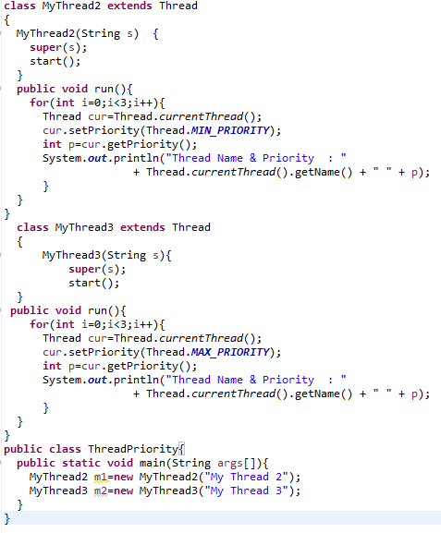

Thread Priorities (Contd…)

Slide 35
Synchronization
When two or more threads need access to a shared resource, they need some way to ensure that the resource will be used by only one thread at a time.
The process by which this is achieved is called synchronization.
Key to synchronization is the concept of monitor (also called a semaphore).
A monitor is an object that is used as a mutually exclusive lock, or mutex.
Only one thread can own a monitor at a given time.
When a thread acquires a lock, it is said to have entered the monitor.
All other threads attempting to enter the locked monitor will be suspended until the first thread exits the monitor. These other threads are said to be waiting for the monitor.
A thread that owns a monitor can reenter the same monitor if it so desires.
You can synchronize your code in either of two ways
Using Synchronized Methods
Using synchronized Statement

Slide 36
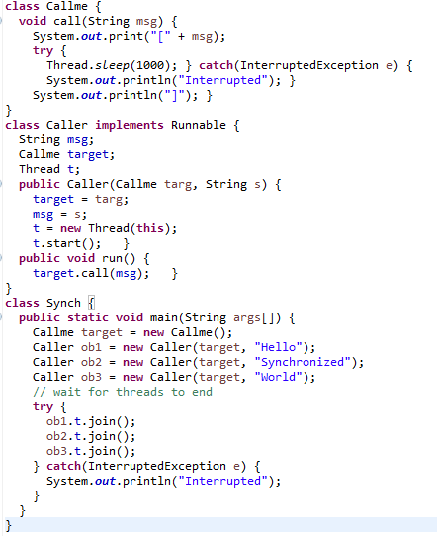

Without Synchronization

Slide 37
Without Synchronization
As you saw, by calling sleep(), the call() method allows execution to switch to another thread.
In this program, nothing exists to stop all three threads from calling the same method, on the same object, at the same time. This is known as a race condition, because the three threads are racing each other to complete the method.
To fix the preceding program, you must serialize access to call( ). That is, you must restrict its access to only one thread at a time. To do this, you simply need to precede call( )’s definition with the keyword synchronized,
This prevents other threads from entering call( ) while another thread is using it. After synchronized has been added to call( ), the output of the program is as follows:

Slide 38
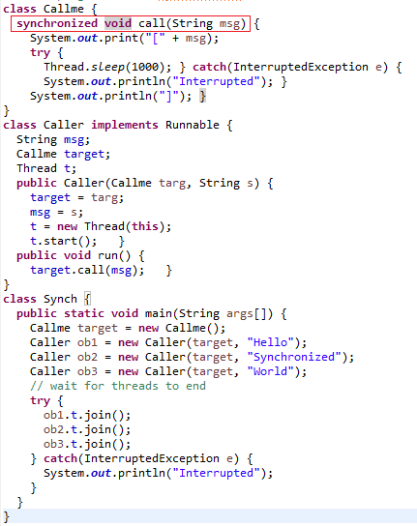

Synchronized Methods

Slide 39
The Synchronized Statement
Imagine that you want to synchronize access to objects of a class that was not designed for multithreaded access. That is, the class does not use synchronized methods.
Further, this class was not created by you, but by a third party, and you do not have access to the source code.
Thus, you can’t add synchronized to the appropriate methods within the class.
How can access to an object of this class be synchronized?
The solution to this problem is quite easy: You simply put calls to the methods defined by this class inside a synchronized block.

Slide 40
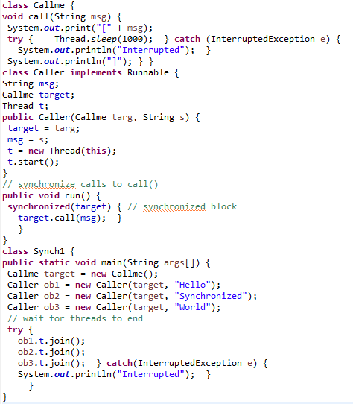
The Synchronized Statement

Slide 41
Synchronization
Producer / Consumer Example:
There are 2 threads, a producer & a consumer, both accessing the same object of type CubbyHole
CubbyHole is a simple object that holds a single value as its contents
The producer thread randomly generates values and stores them in the CubbyHole object
The consumer then retrieves these values as they are generated by the producer

Slide 42
Synchronization: Producer
public class Producer extends Thread
{
private CubbyHole cubbyhole;
public Producer(CubbyHole c) {
cubbyhole = c;
}
public void run() {
for (int i = 0; i < 10; i++) {
cubbyhole.put(i);
try {
sleep((int)(Math.random() * 100));
} catch (InterruptedException e) { }
}
}
}

Slide 43
Synchronization: Consumer
public class Consumer extends Thread
{
private CubbyHole cubbyhole;
public Consumer(CubbyHole c) {
cubbyhole = c;
}
public void run() {
int value = 0;
for (int i = 0; i < 10; i++) {
value = cubbyhole.get();
}
}
}

Slide 44
Synchronization: Problems
When the producer produces a value, it stores it in the CubbyHole, and then the consumer is only supposed to retrieve it, once and only once
Depending on how the threads are scheduled:
The producer could produce two values before the consumer is able to retrieve one
The consumer could consume the same value twice before the producer has produced the next value
If the producer & consumer access the cubbyhole at the same time, they could produce an inconsistent state or miss a produced value

Slide 45
Synchronization: Solution
When a thread executes a synchronized method, it locks the object of the method
No synchronized methods can be called by another thread on that object until it is unlocked
public class CubbyHole
{
private int contents;
private boolean available = false;
public synchronized int get()
{ ... }
public synchronized void put(int value)
{ ... }
}

Slide 46
Synchronization: Wait / Notify
Synchronized methods stop the producer & consumer from modifying the CubbyHole at the same time
public synchronized int get() {
while (available == false) {
try {
//wait for Producer to put value
wait();
} catch (InterruptedException e) { }
}
available = false;
//notify Producer that value has been retrieved
notifyAll();
return contents;
}

Slide 47
InterThread Communication
Producer-Consumer Problem:
Producer has to wait until the consumer is finished before it generates more data.
Consumer would waste many CPU cycles while it is waited for the producer to produce.
This kind of situation is called polling.
To avoid polling, following methods are used:
wait( ) tells the calling thread to give up the monitor and go to sleep until some other thread enters the same monitor and calls notify( ).
notify( ) wakes up a thread that called wait( ) on the same object.
notifyAll( ) wakes up all the threads that called wait( ) on the same object. One of the threads will be granted access.

Slide 48
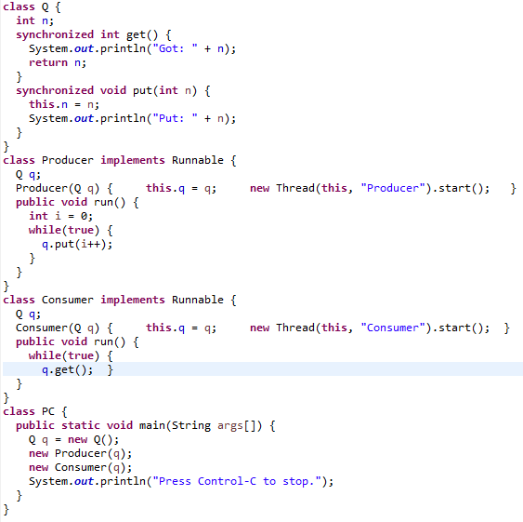

Producer Consumer Problem

Slide 49
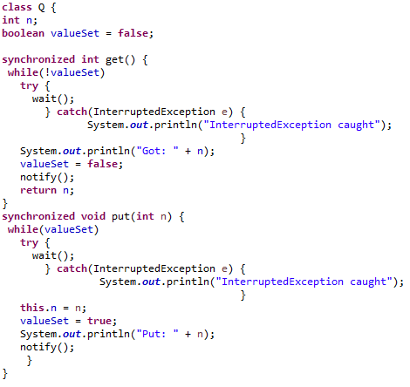
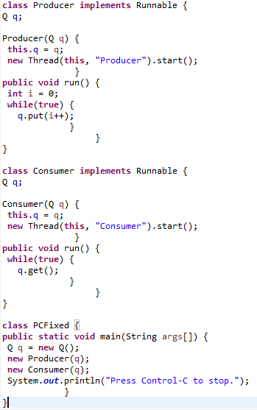

Producer Consumer Problem

Slide 50
Deadlock
Occurs when two threads have a circular dependency on a pair of synchronized objects.
For example, suppose one thread enters the monitor on object X and another thread enters the monitor on object Y. If the thread in X tries to call any synchronized method on Y, it will block as expected.
However, if the thread in Y, in turn, tries to call any synchronized method on X, the thread waits forever, because to access X, it would have to release its own lock on Y so that the first thread could complete.

Slide 51
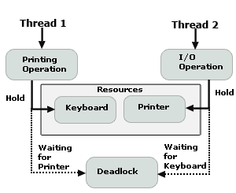
Thread Deadlock (Contd…)
If a thread is waiting for an object lock held by the second thread
The second thread is waiting for an object lock held by the first one
Example: 2 threads having printing & I/O operations respectively at a time
Thread1 needs a printer which is held by Thread2
Thread2 needs the keyboard which is held by Thread1

Slide 52
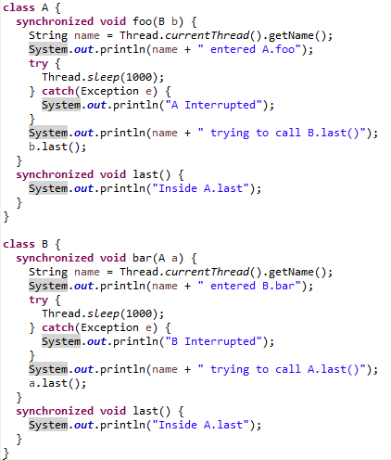
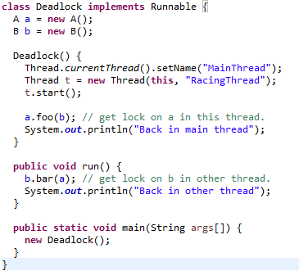

Deadlock

Slide 53
THANK YOU!!
ANY QUESTIONS??

